Slide 1
Quadratic Sieve Algorithm
Basile Hurat
Math 626
5/16/2019

Slide 2
What is the Quadratic Sieve?
The Quadratic Sieve algorithm is a large integer factorization algorithm
Currently, it is the second fastest algorithm for factoring large integers
Current fastest is Number Field Sieve Algorithm
For numbers less than 110 digits, Quadratic Sieve is faster
Similar in concept to the Dixon Random Squares algorithm

Slide 3
History of Quadratic Sieve
1600’s: Fermat proposed using Difference of Squares for factoring integers
1977: RSA cryptographic system proposed. Study of factoring algorithm takes off
1981: Dixon Random Squares proposed by John Dixon. Expands on idea w/ factor base approach
1981: Quadratic Sieve proposed by Carl Pomerance. Improves on Dixon Random Squares and uses sieving approach
1993: Quadratic Sieve is surpassed by Number Field Sieve as fastest integer factorization algorithm
1994: Quadratic Sieve cracks RSA-129 using 1600+ computers in parallel

Slide 4
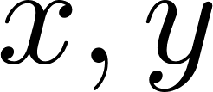
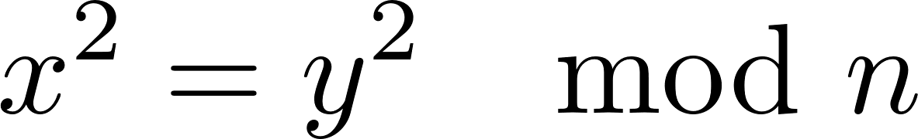
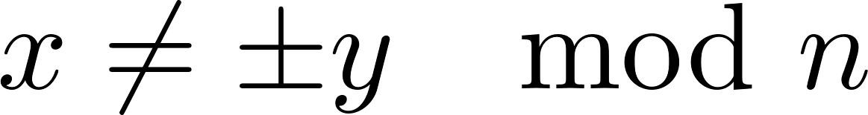

Approach of Quadratic Sieve
Attempts to search for such that
Construct a factor base
Sieve through an interval, decomposing numbers into factor base
Find combination of factor numbers that multiply to a perfect square
Use difference of squares and GCD to find factors
Check that factors are not trivial (1 and )
Check primality of result
If not prime, repeat on result

Slide 5
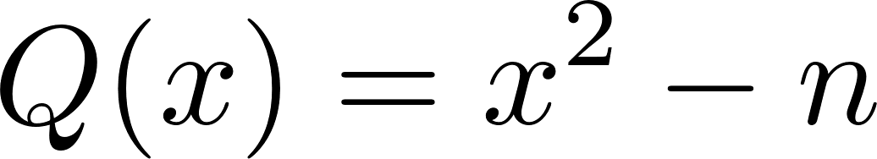
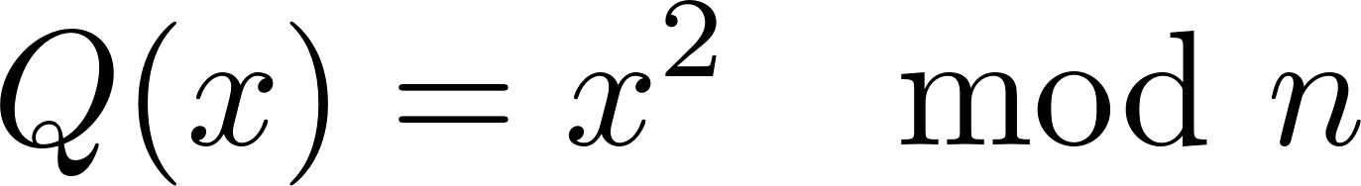
Why It Is Called The Quadratic Sieve
Rather than trying numbers, you consider this quadratic
Clearly,
We will exploit this multiple times

Slide 6


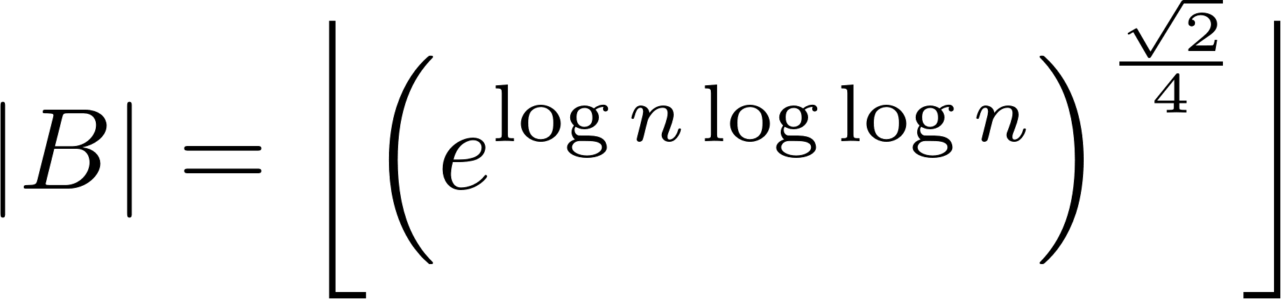
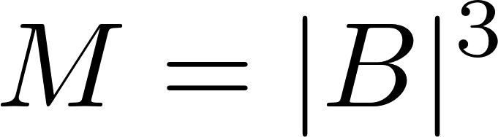
Factor Base and Sieve Interval
Ideally we want our factor base to be
Small so that it’s quick to operate over
Not too small so that we find smooth numbers
Similarly…
Ideally, sieving interval size should be
Small so that it’s quick to operate over
Not too small so that we find smooth numbers
According to [2], optimal sizes exist based on integer

Slide 7
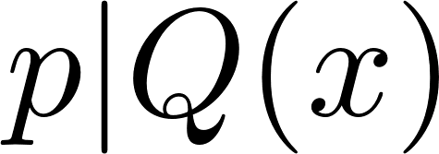
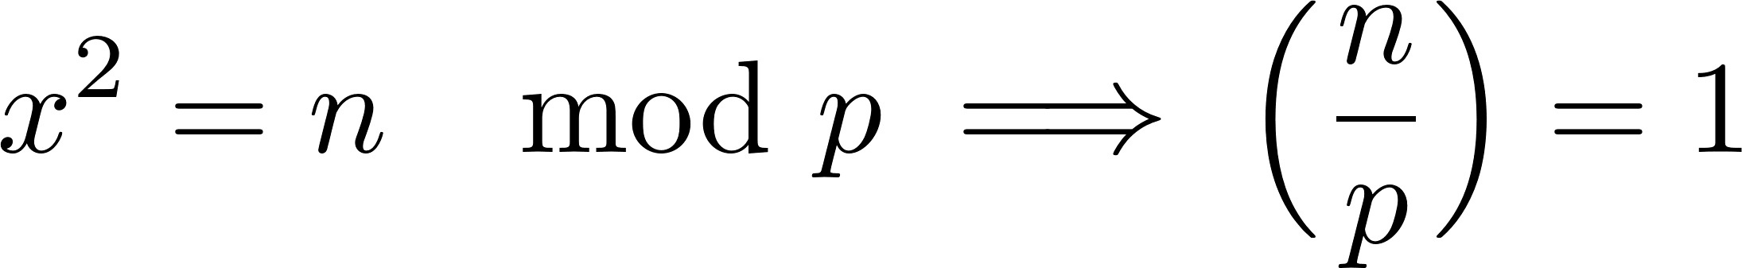


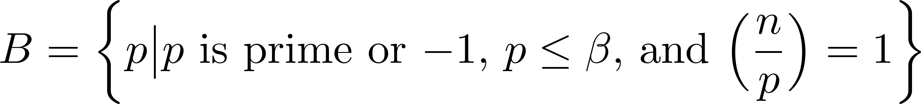
Constructing Our Factor Base
Given
If then
So we want our factor base to be of primes that are smaller than some who has as a quadratic residue

Slide 8
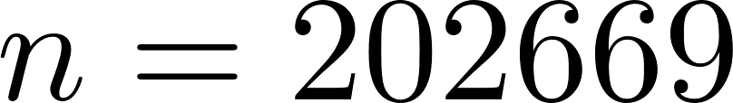
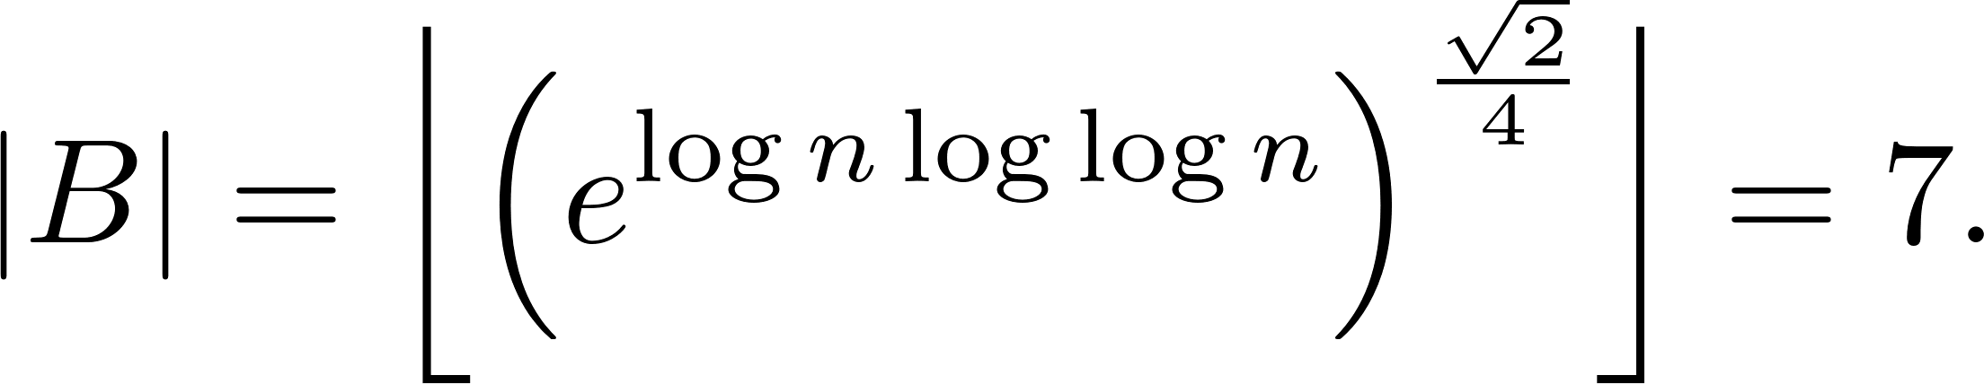
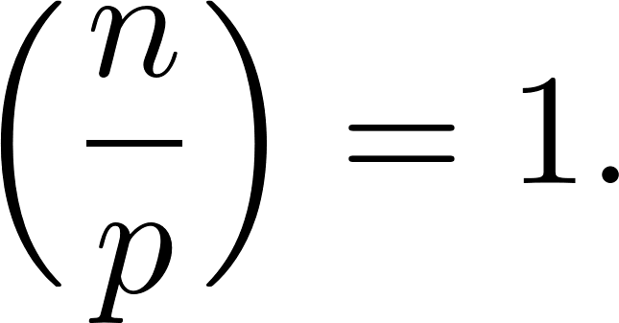
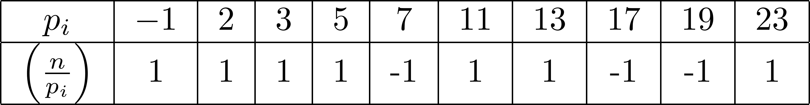
Example:
We begin by calculating the size of our factor base
Then, we calculate Legendre symbol of primes until we have 7 primes with
This gets us our factor base

Slide 9
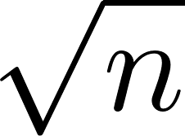

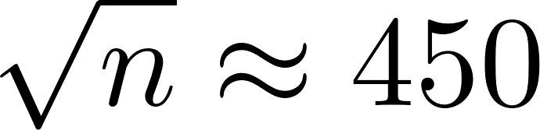
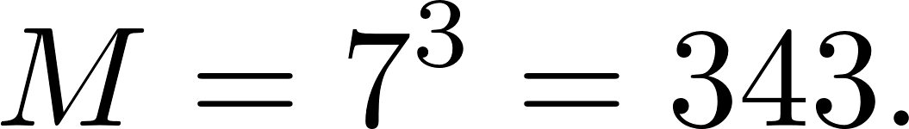
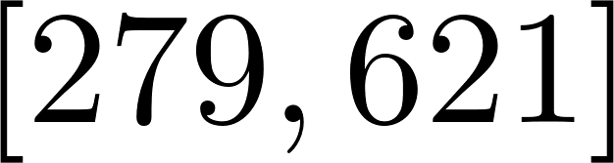
Choosing a Sieving Interval
Middle should be around . Then, we have a sieving interval of size
For our example of , we have
and
Thus, our sieving interval is:

Slide 10
Sieving
The goal of sieving:
Look at
If it factors completely in our factor base:
Smooth and keep
If not
Throw it away
However, instead of working one number at a time, we can work with the whole interval at once! This is what we call sieving

Slide 11
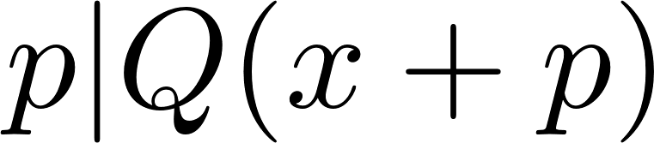
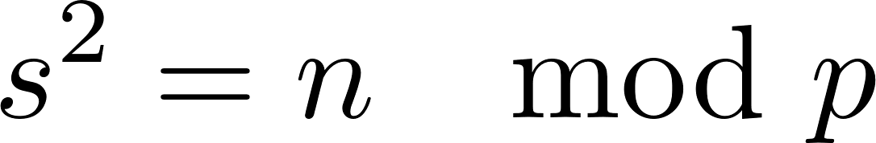
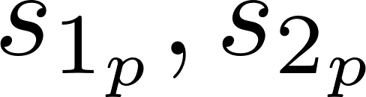
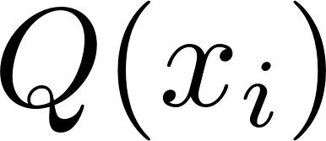
Sieving
Suppose . Then, we can see that
So if we consider ,we see that there exists and (by using Tonelli-Shanks algorithm), we can find the modular square roots .
Then,
So we can create subintervals and within that, divide out the highest power of out of each in the interval.

Slide 12
Example:
In our sieving, we look at the first few. Notice the patterns!

Slide 13
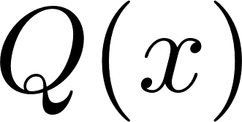

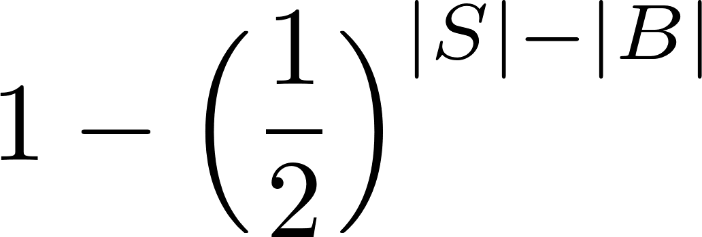
Building our matrix
So once we go through each prime, we will have some number of that get factored completely. This creates our -smooth subset
For each of these, we create a vector of size equal to the # of primes in our factor base
For each prime in our factor base, we count how many times they go into each number in our -smooth subset mod 2
With these vectors, we construct a matrix
NOTE 1: If has less elements than our factor base, we have to go back and sieve a second interval to get more - smooth
NOTE 2: The probability of finding nontrivial answer in our matrix is

Slide 14


Finding linear dependent vectors
Given we have enough vectors such that we have more rows than columns in our matrix
We look to solve
where
Find linear combination of rows such that we have a zero vector
This can be done easily with Gaussian elimination!

Slide 15
Example:
By the end of the sieve, we have the following smooth numbers (and their vectors)

Slide 16

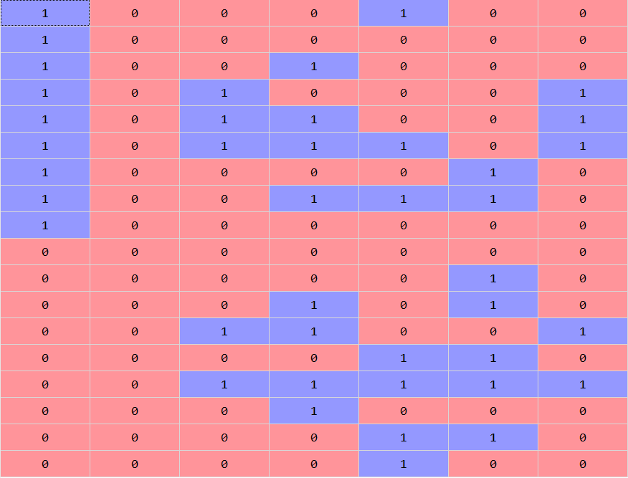
Example:
 |  | -1 | 2 | 3 | 5 | 11 | 13 | 23
337 | -89100
387 | -52900
392 | -49005
395 | -46644
418 | -27945
433 | -15180
437 | -11700
447 | -2860
450 | -169
455 | 4356
463 | 11700
473 | 21060
487 | 34500
499 | 46332
502 | 49335
513 | 60500
554 | 104247
612 | 171875

Slide 17
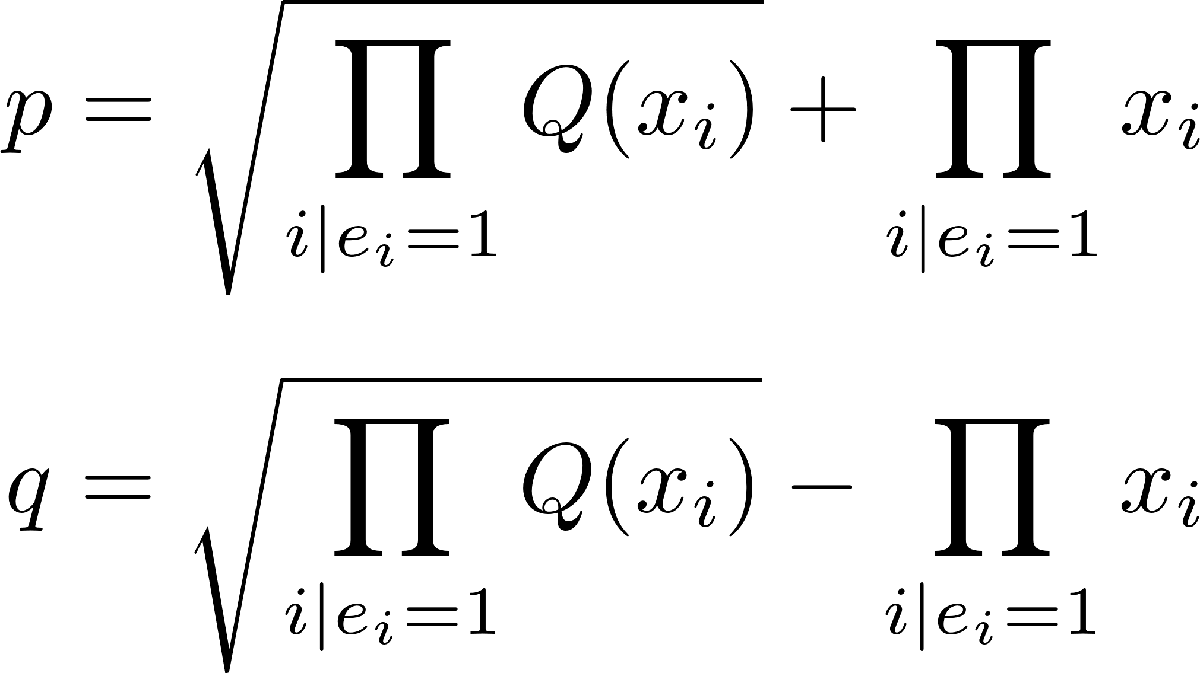
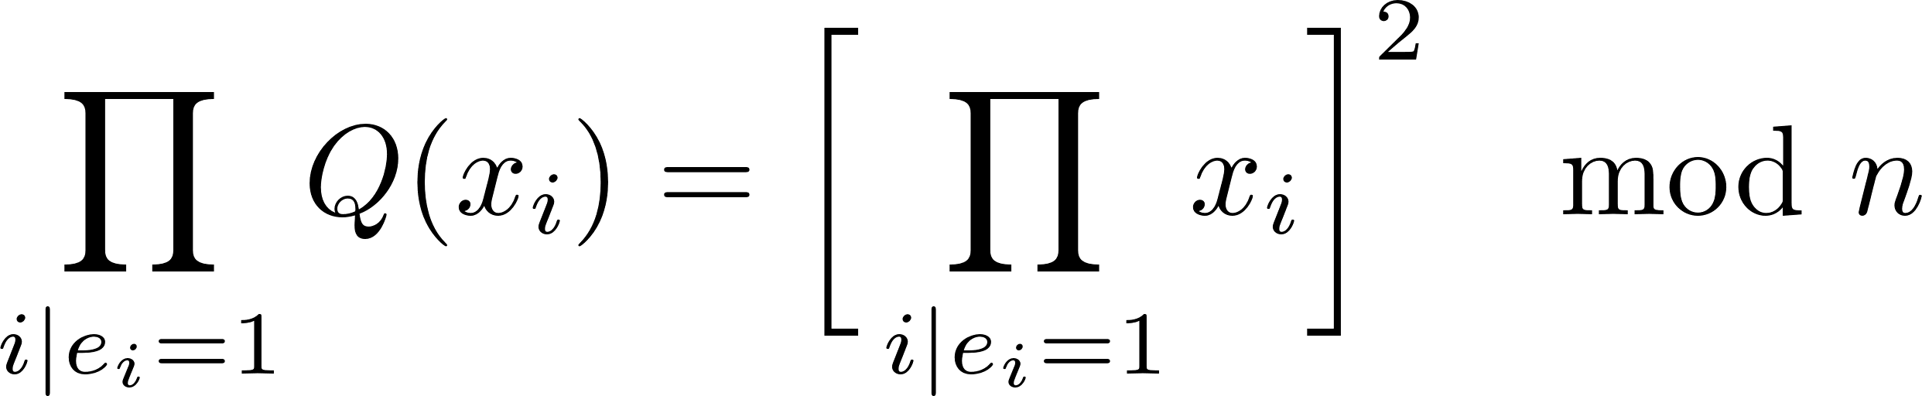
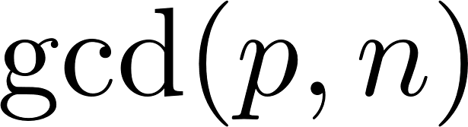

Checking our resulting factor
Once we have a linear combination of that correspond to in our -smooth subset, we calculate and use difference of squares to get two factors
Then, we check . This is our factor! We check to guarantee that it is nontrivial (1 or )
Lastly, we check the primality of and . This step is unnecessary when attacking RSA

Slide 18

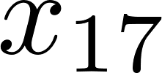
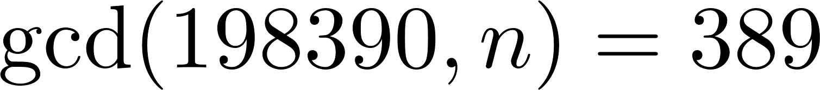
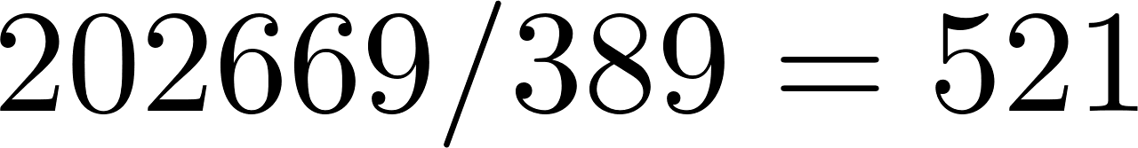
Example: n = 202669
We have many possible linear combinations that could work. We walk through the choice of and

Slide 19
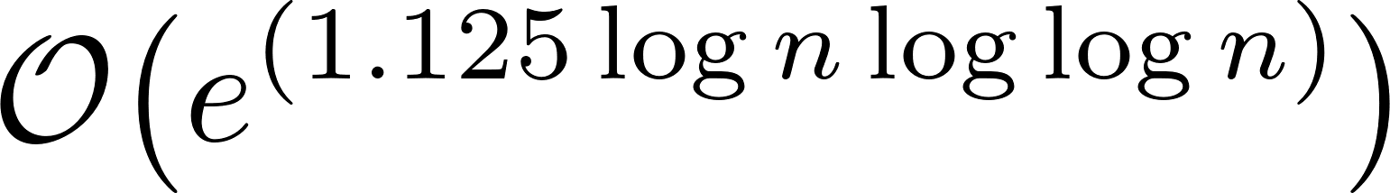
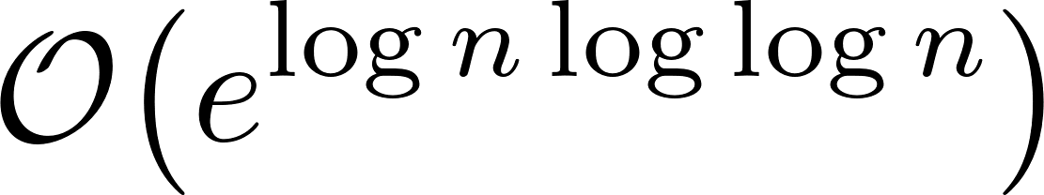
Final Thoughts
Quadratic Sieve Algorithm implemented naively has complexity
One can use a Gaussian elimination specifically for mod 2 that was proposed by Wiederman to approach complexity
Furthermore, one can parallelize the Quadratic Sieve by operating on different intervals in parallel or by using polynomials aside from in parallel

Slide 20
Sources
[1] Eric Landquist, ”The Quadratic Sieve Factoring Algorithm”, 2001.
[2] Joseph L. Gerver, ”Factoring Large Numbers with a Quadratic Sieve”, Mathematics of Computation, Vol. 41, No. 163, 1983.
[3] Carl Pomerance, ”Analysis and Comparison of Some Integer Factoring Algorithms, in Computational Methods in Number Theory”, , H.W. Lenstra,Jr. and R. Tijdeman, eds., 1982
[4] Carl Pomerance, ”Smooth Numbers and the Quadratic Sieve”, Algorithmic Number Theory, MSRI Publications, Volume 44, 2008.
[5] Carl Pomerance, ”The Number Field Sieve”, Proceedings of Symposia in Applied Mathematics, Volume 48, 1994.
[6] D. Wiedemann, “Solving Sparse Linear Equations over Finite Fields”, IEEE Trans. Inform. Theory, 32, 1986.
[7] Douglas R Stinson, Maura B. Paterson, ”Cryptography: Theory and Practice 4e”, CRC Press, 2018.
[8] G. L. Honaker, Jr., ”Prime Curios”, shttps://primes.utm.edu/curios/home.php
[9] Rosetta Code, ”Tonelli-Shanks Algorithm”, ”https://rosettacode.org/wiki/Tonelli-Shanks algorithm”

